Slide 1

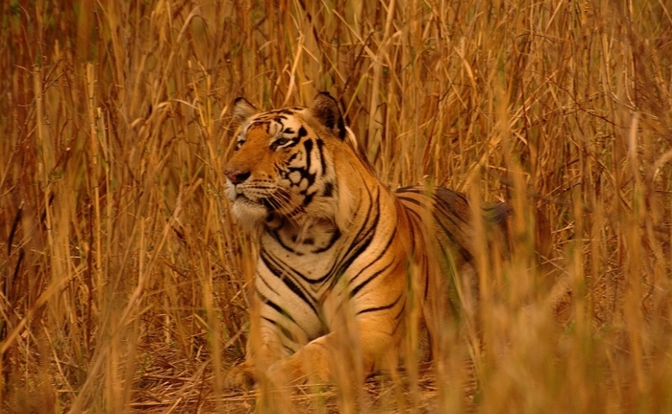
Adaption of XCS to Multi-Learner Predator/Prey Scenarios
Clemens Lode, Urban Richter, Hartmut Schmeck
Karlsruhe Institute of Technology (Germany)
Institute AIFB
July, GECCO 2010
http://www.flickr.com/photos/shreeram

Slide 2
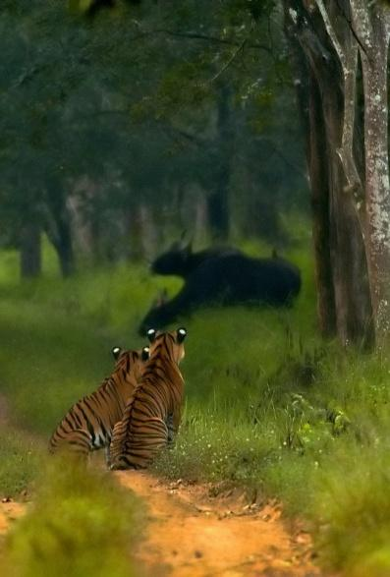
Outline
Learning Classifier Systems
XCS in Predator/Prey Scenarios
Adapting the Reward Function
Experimental Results
http://www.flickr.com/photos/yathin

Slide 3
Environment
Input: 0011
Population [P]
C A ρ ε F
#011 : 01 43 .01 99
11## : 00 32 .13 9
#0## : 11 14 .05 52
001# : 01 27 .24 3
#0#1 : 11 18 .02 92
1#01 : 10 24 .17 15
…
Action: 01
Reward
Prediction array
Action set [A]
Match set [M]
Action
selection
00 01 10 11
nil 42.5 nil 16.6
#011 : 01 43 .01 99
001# : 01 27 .24 3
#011 : 01 43 .01 99
#0## : 11 14 .05 52
001# : 01 27 .24 3
#0#1 : 11 18 .02 92
Max
Discount
+
Delay = 1
P
Previous
action set [A]₋₁
Genetic
operators
Covering
Update ρ ε F
Wilson, S. W. Koza, J. R. & others (ed.) Generalization in the XCS Classifier System Genetic Programming 1998: Proceedings of the Third Annual Conference, 1998, 665-674

Slide 4
Learning Classifier Systems
Standard (Multi-Step) Problem:
Maze6
Goal:
Find the shortest path to from a random position to food
T: Tree
F: Food

Slide 5
Learning Classifier Systems
Problem:
Limited sensors, no global knowledge
Partially observable Markov decision process
Solution:
Iterations, back-propagation of reward
T: Tree
F: Food

Slide 6
Learning Classifier Systems
Problem:
Limited sensors, no global knowledge
Partially observable Markov decision process
Solution:
Iterations, back-propagation of reward
Aliasing positions:
Handle by using memory
T: Tree
F: Food

Slide 7
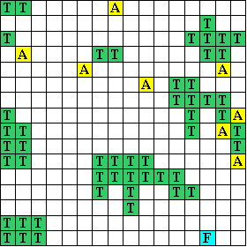
Learning Classifier Systems
Many aliasing positions
Other agents present
Dynamic world
food and other agents move
Limited sensors
T: Trees
F: Food
A: Agent

Slide 8
Predator/Prey Scenarios
Terminology:
Obstacles, prey, predator
Goal: Try to stay near the prey
Global observation task
Runs continuously
Maximize average quality
T: Trees/Obstacles
F: Food/Prey
A: Agent/Predator

Slide 9
Classification of Predator/Prey Scenarios
Access to local information only
Open areas with some obstacles
Internal state unknown to others
No standard MDP
Limited sensors (1, 3)
Aliasing positions (2)

Slide 10
Classification of Predator/Prey Scenarios
Access to local information only
Open areas with some obstacles
Internal state unknown to others
Dynamic scenario
No standard MDP
Limited sensors (1, 3)
Aliasing positions (2)
No POMDP
Non-static scenario (4)

Slide 11
Classification of Predator/Prey Scenarios
Access to local information only
Open areas with some obstacles
Internal state unknown to others
Dynamic scenario
Predators share global observation task
Runs continuously
No standard MDP
Limited sensors (1, 3)
Aliasing positions (2)
No POMDP
Non-static scenario (4)
XCS has to be adapted
No “final” reward (5), no iterations (6)

Slide 12
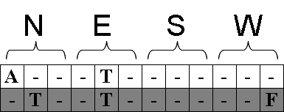
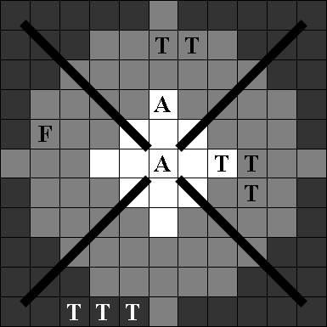
Sensors
One sensor array for each direction

Slide 13
Sensors
Sensors can sense either far or near (observation range / sight range)
One sensor array for each direction

Slide 14
Sensors
Sensors can sense either far or near (observation range / sight range)
Sensors can distinguish between predators, prey, and obstacles
One sensor array for each direction

Slide 15
Adaption of the Standard XCS Reward Function
Standard implementation:
Adapted implementation

Slide 16
Adaption of the Standard XCS Reward Function
Standard implementation:
Reward:
Prey is in a neighboring cell
Adapted implementation
Reward:
Prey is in observation range (“XCS obs”)
Prey is in sight range (“XCS sight”)

Slide 17
Adaption of the Standard XCS Reward Function
Standard implementation:
Reward:
Prey is in a neighboring cell
Action:
Assign reward
Restart scenario
Switch between explore/exploit phase
Adapted implementation
Reward:
Prey is in observation range (“XCS obs”)
Food is in sight range (“XCS sight”)
Action:
Assign reward
Continue scenario
Always use exploit phase

Slide 18
Classification of Predator/Prey Scenarios
Global knowledge cannot be reconstructed
Memory becomes invalid after each step
The predator/prey scenario is a Non-observable Markov Decision Processes

Slide 19
Classification of Predator/Prey Scenarios
Global knowledge cannot be reconstructed
Memory becomes invalid after each step
The predator/prey scenario is a Non-observable Markov Decision Processes
Despite being a NOMDP, can the XCS still learn?

Slide 20
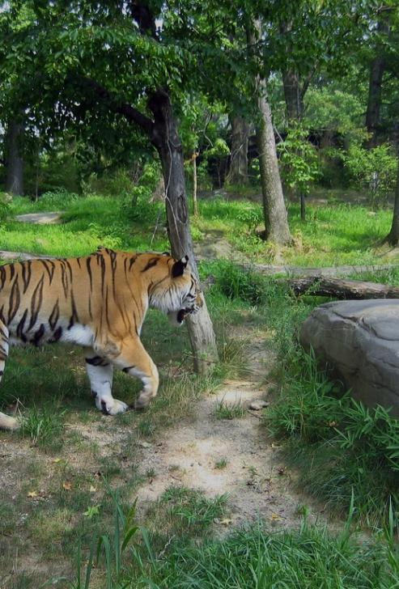
Testing Methodology
“XCS obs”, “XCS sight”
“Obstacle-evading prey”
“Predator-evading prey”
“Blinded Prey”
Standard XCS parameter settings
2,000,000 steps
Reset of XCS every 20,000 steps
Reset of scenario (new random positions) every 2,000 steps
http://www.flickr.com/photos/james_crowley

Slide 21
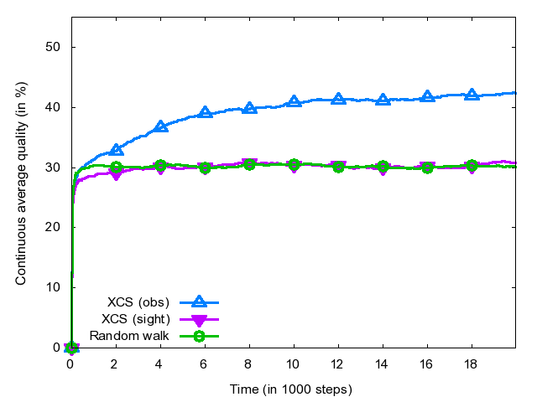
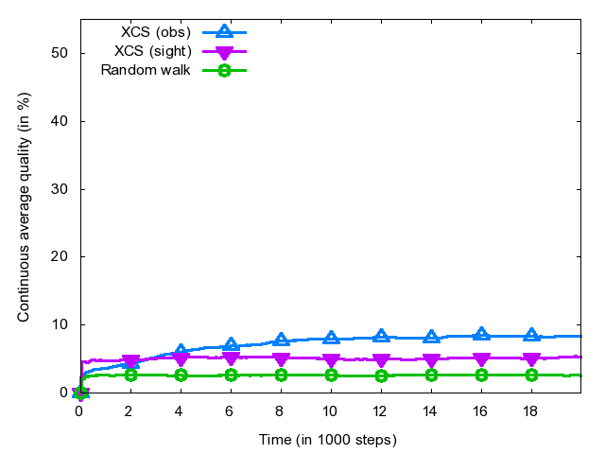
XCS Experimental Results “Pillar Scenario”
XCS (obs) shows some learning
Obstacle-evading prey
Predator-evading prey

Slide 22
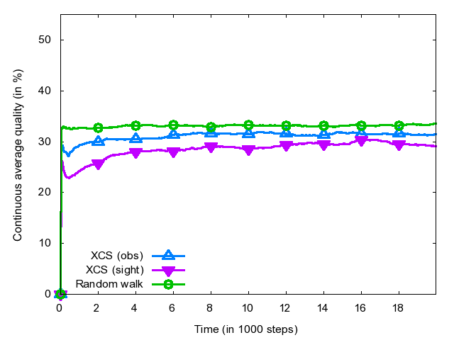
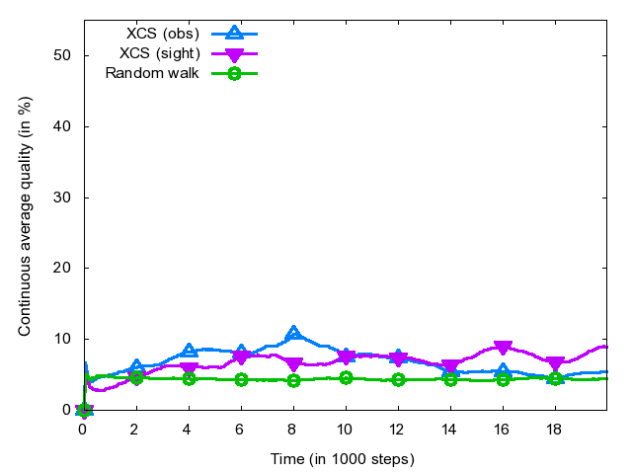
XCS Experimental Results “Random Scenario”
XCS shows very little learning
Obstacle-evading prey
Predator-evading prey

Slide 23
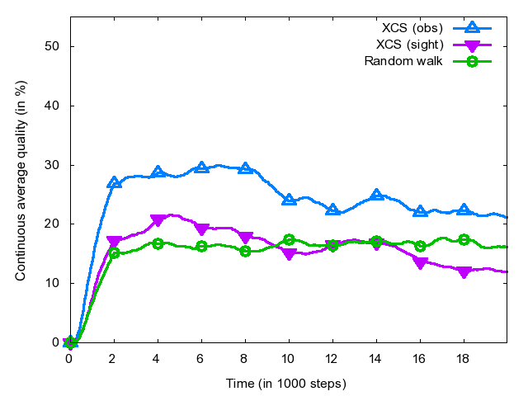
XCS Experimental Results “Difficult Scenario”
XCS shows significant learning
But also unlearning after 8,000 steps
“Difficult Scenario” is a maze-like scenario, this result was expected
Blinded prey

Slide 24
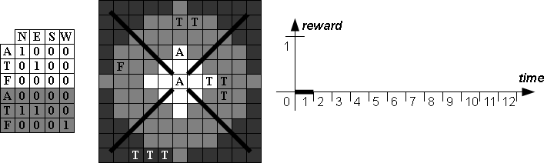
Reward Events “eventXCS”

Slide 25
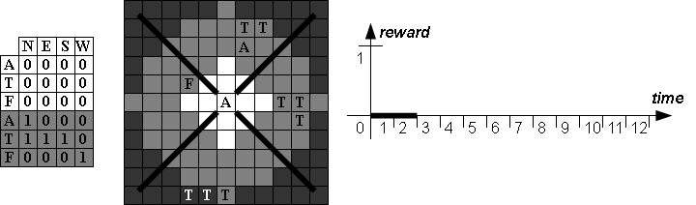
Reward Events “eventXCS”

Slide 26
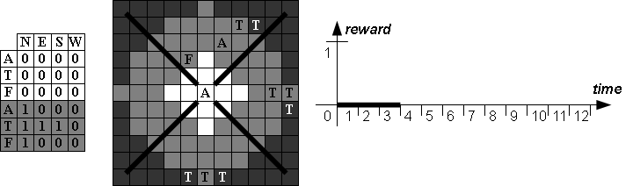
Reward Events “eventXCS”

Slide 27
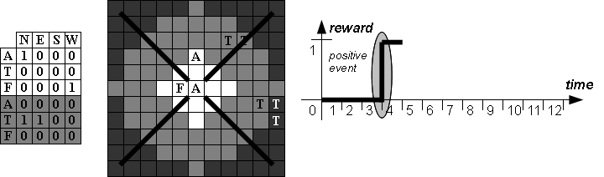
Reward Events “eventXCS”

Slide 28
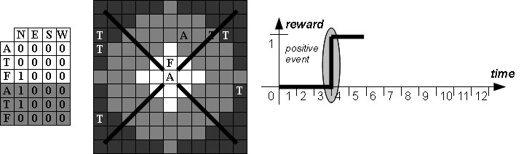
Reward Events “eventXCS”

Slide 29

Reward Events “eventXCS”

Slide 30
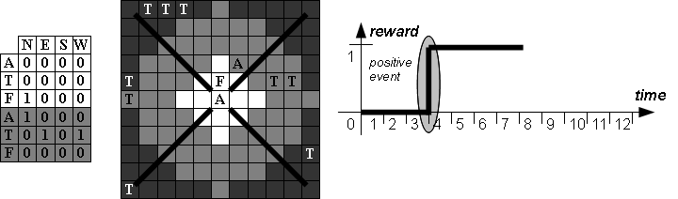
Reward Events “eventXCS”

Slide 31
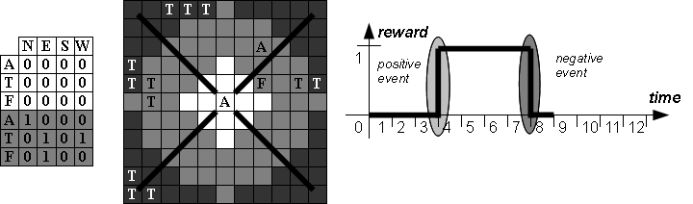
Reward Events “eventXCS”

Slide 32
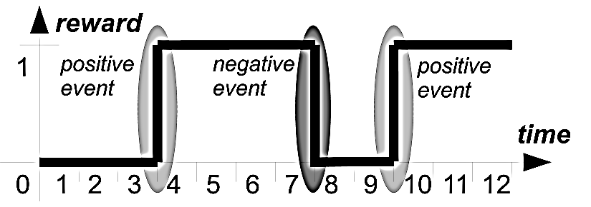
Reward Distribution “eventXCS”
Analyze succession of positive and negative events

Slide 33
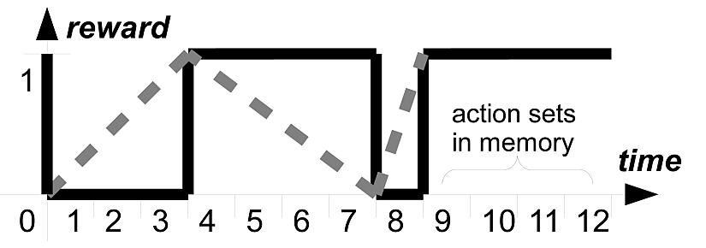
Reward Distribution “eventXCS”
Analyze succession of positive and negative events
Distribute the reward as soon as possible (i.e. at each event)
Idea:
Action sets close to an event probably contributed TODO

Slide 34
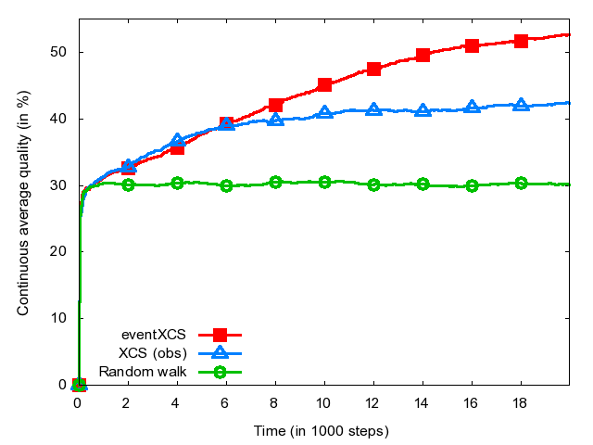
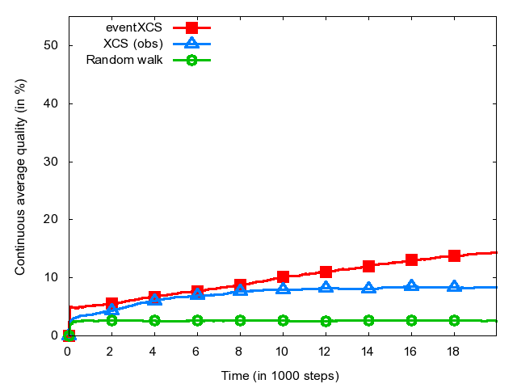
Experimental Results “Pillar Scenario”
eventXCS clearly outperforms XCS
Obstacle-evading prey
Predator-evading prey

Slide 35
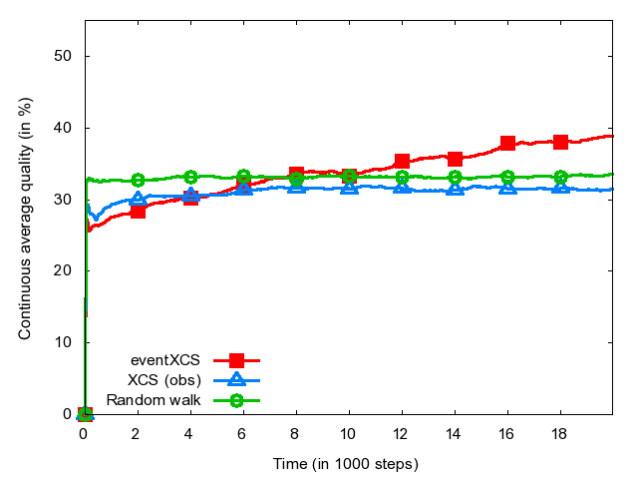
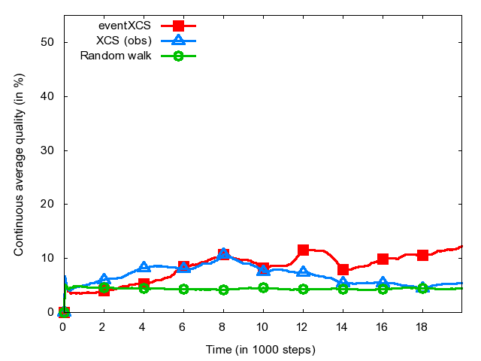
Experimental Results “Random Scenario”
eventXCS shows slow but steady learning with an obstacle-evading prey
Obstacle-evading prey
Predator-evading prey

Slide 36
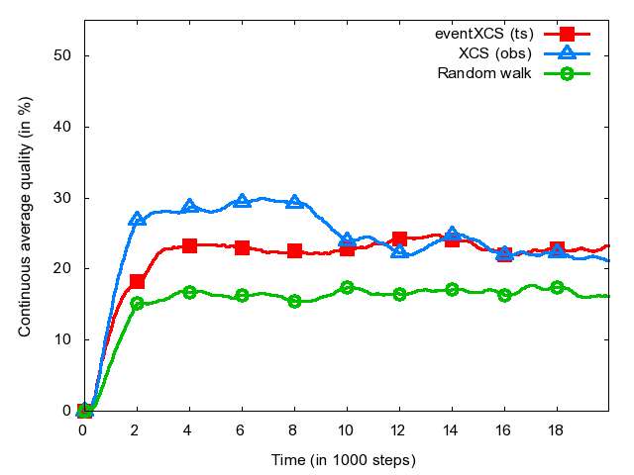
Experimental Results “Difficult Scenario”
eventXCS fails in this scenario
Using “tournament selection” shows acceptable results with no sign of unlearning
Blinded prey

Slide 37
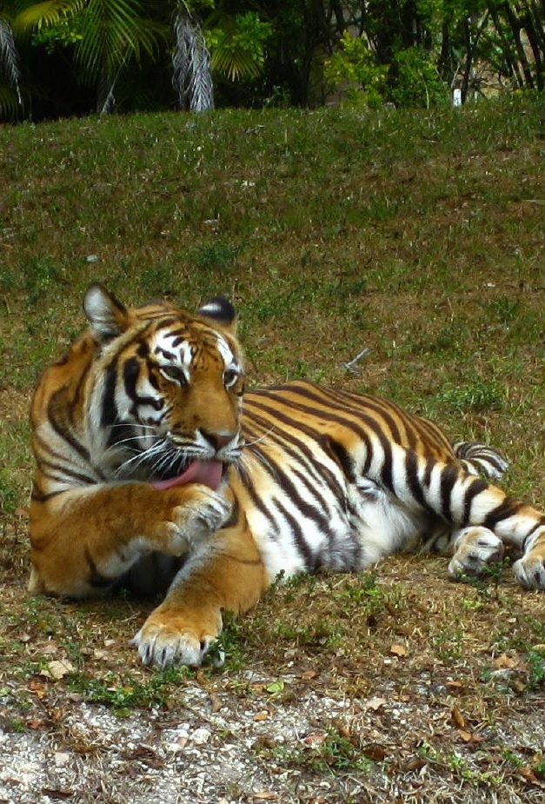
Conclusion
XCS with minimal adaptions can learn
Unable to use sight range
Event XCS superior
Questions?

Slide 38
Backup slides

Slide 39
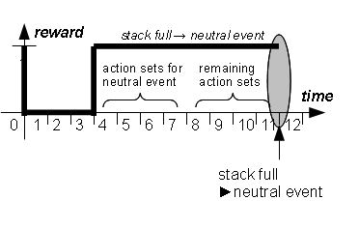
Neutral Events
Neutral Event
No positive or negative event for a number of steps
Half of the action sets is discarded and receives reward
Idea:
Good actions are rewarded earlier
Preventing of dead ends
39

Slide 40
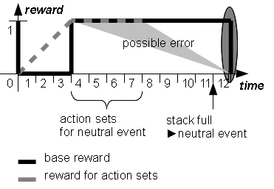
Neutral Events
Neutral Event
No positive or negative event for a number of steps
Half of the action sets is discarded and receives reward
Idea:
Good actions are rewarded earlier
Preventing of dead ends
Problem:
Error possibility high if directly followed by an event.
40

Slide 41
Neutral Events
Tests have shown that a stack size of 8 is generally good for all three scenarios
“Pillar Scenario”
“Random Scenario”
“Difficult Scenario”

Slide 42
Learning Rate β
Pillar Scenario
Obstacle-evading prey
Low learning rate (0.05) good, eventXCS very stable

Slide 43
Learning Rate β
Random Scenario, Obstacle evading prey
Pillar Scenario Predator-evading prey
Random Scenario, Predator evading

Slide 44
Learning Rate β
Difficult Scenario
Blind prey
High learning rates show an advantage because of long distance to the prey

